Slide 1
THRIVE
as a witness to Christ
in the workplace
You will need your phone to interact with this seminar

Slide 2
THRIVE
as a witness to Christ
in the workplace

Slide 3
What is your job?
ⓘ Start presenting to display the poll results on this slide.

Slide 4
To what extent are you thriving as a witness to Christ in your workplace?
ⓘ Start presenting to display the poll results on this slide.

Slide 5
A bit about me…

Slide 6
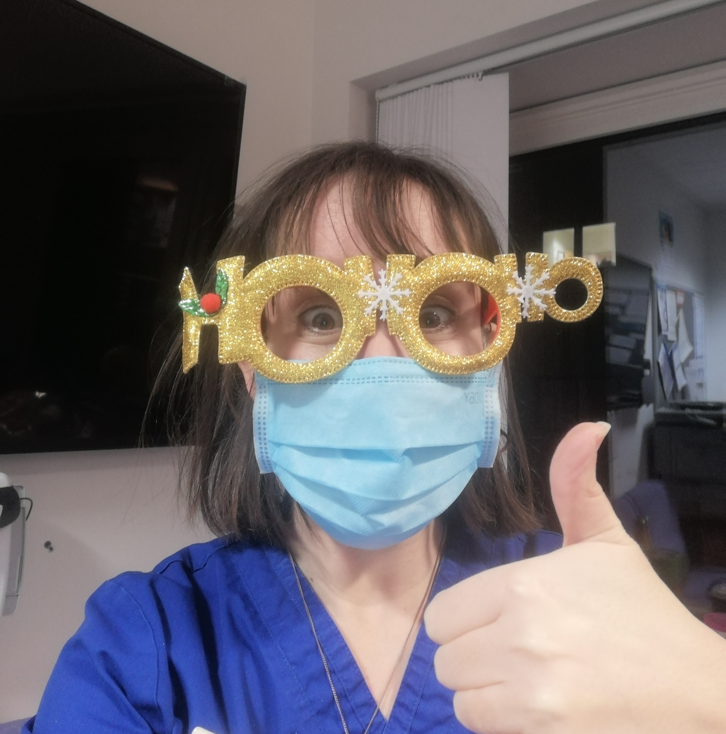
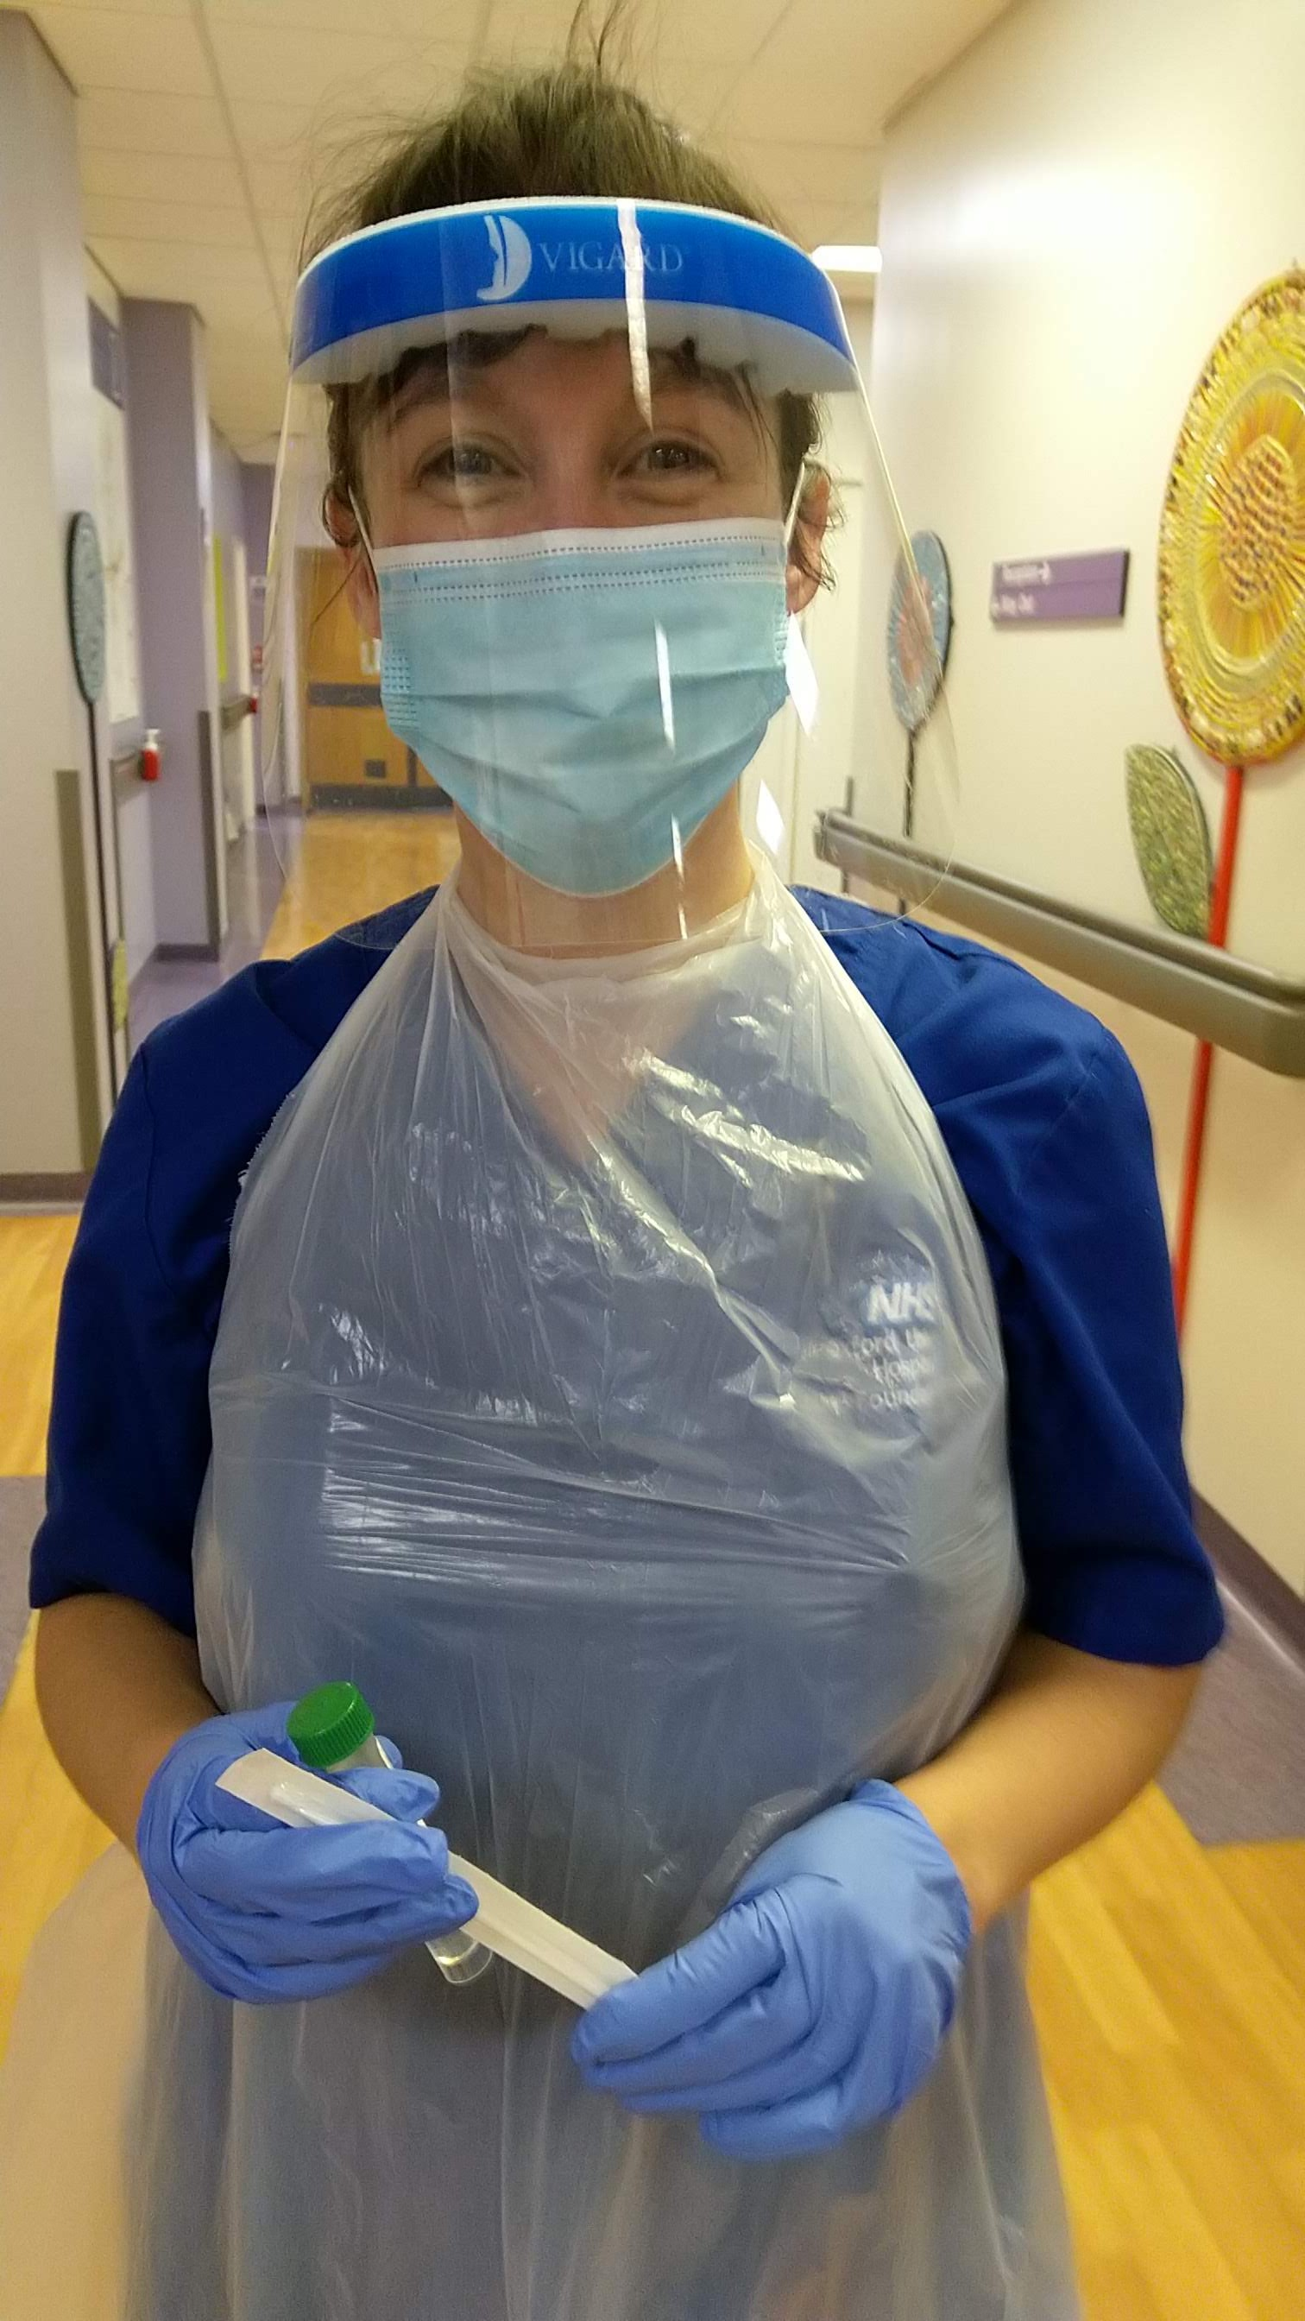
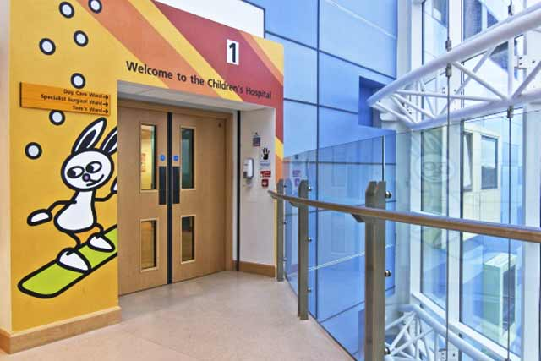
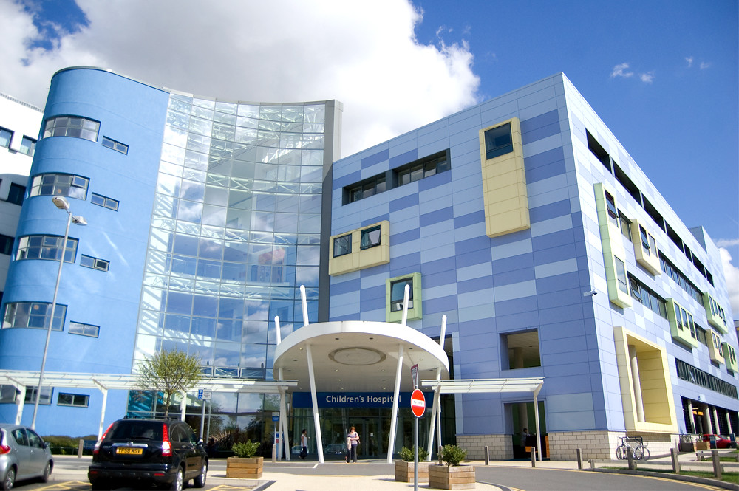
Senior Staff Nurse
at CHOX

Slide 7
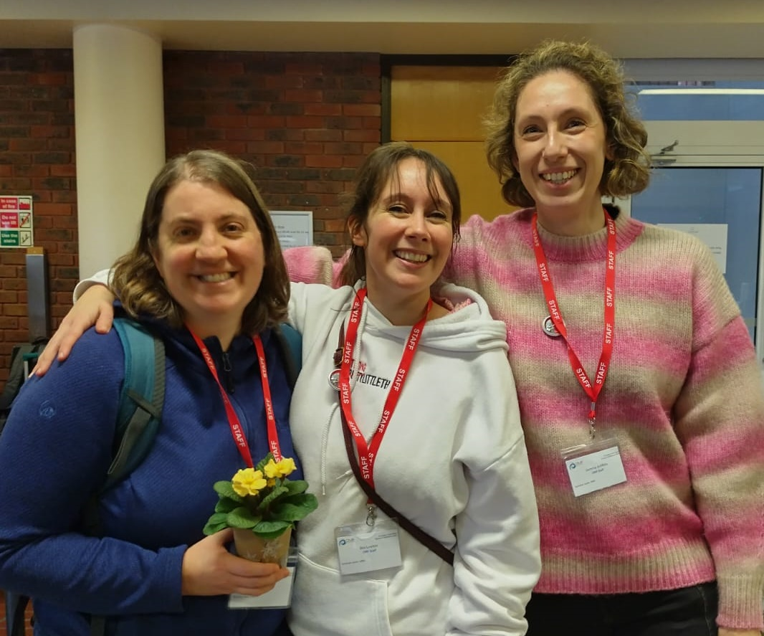
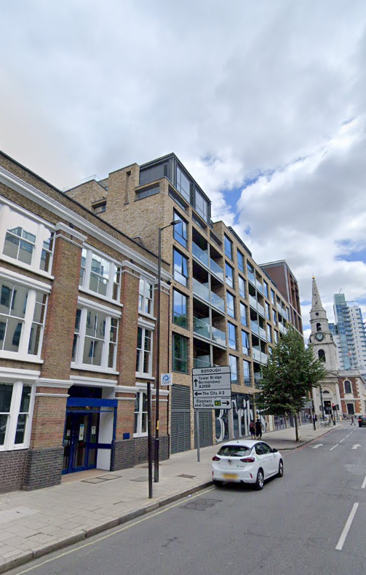
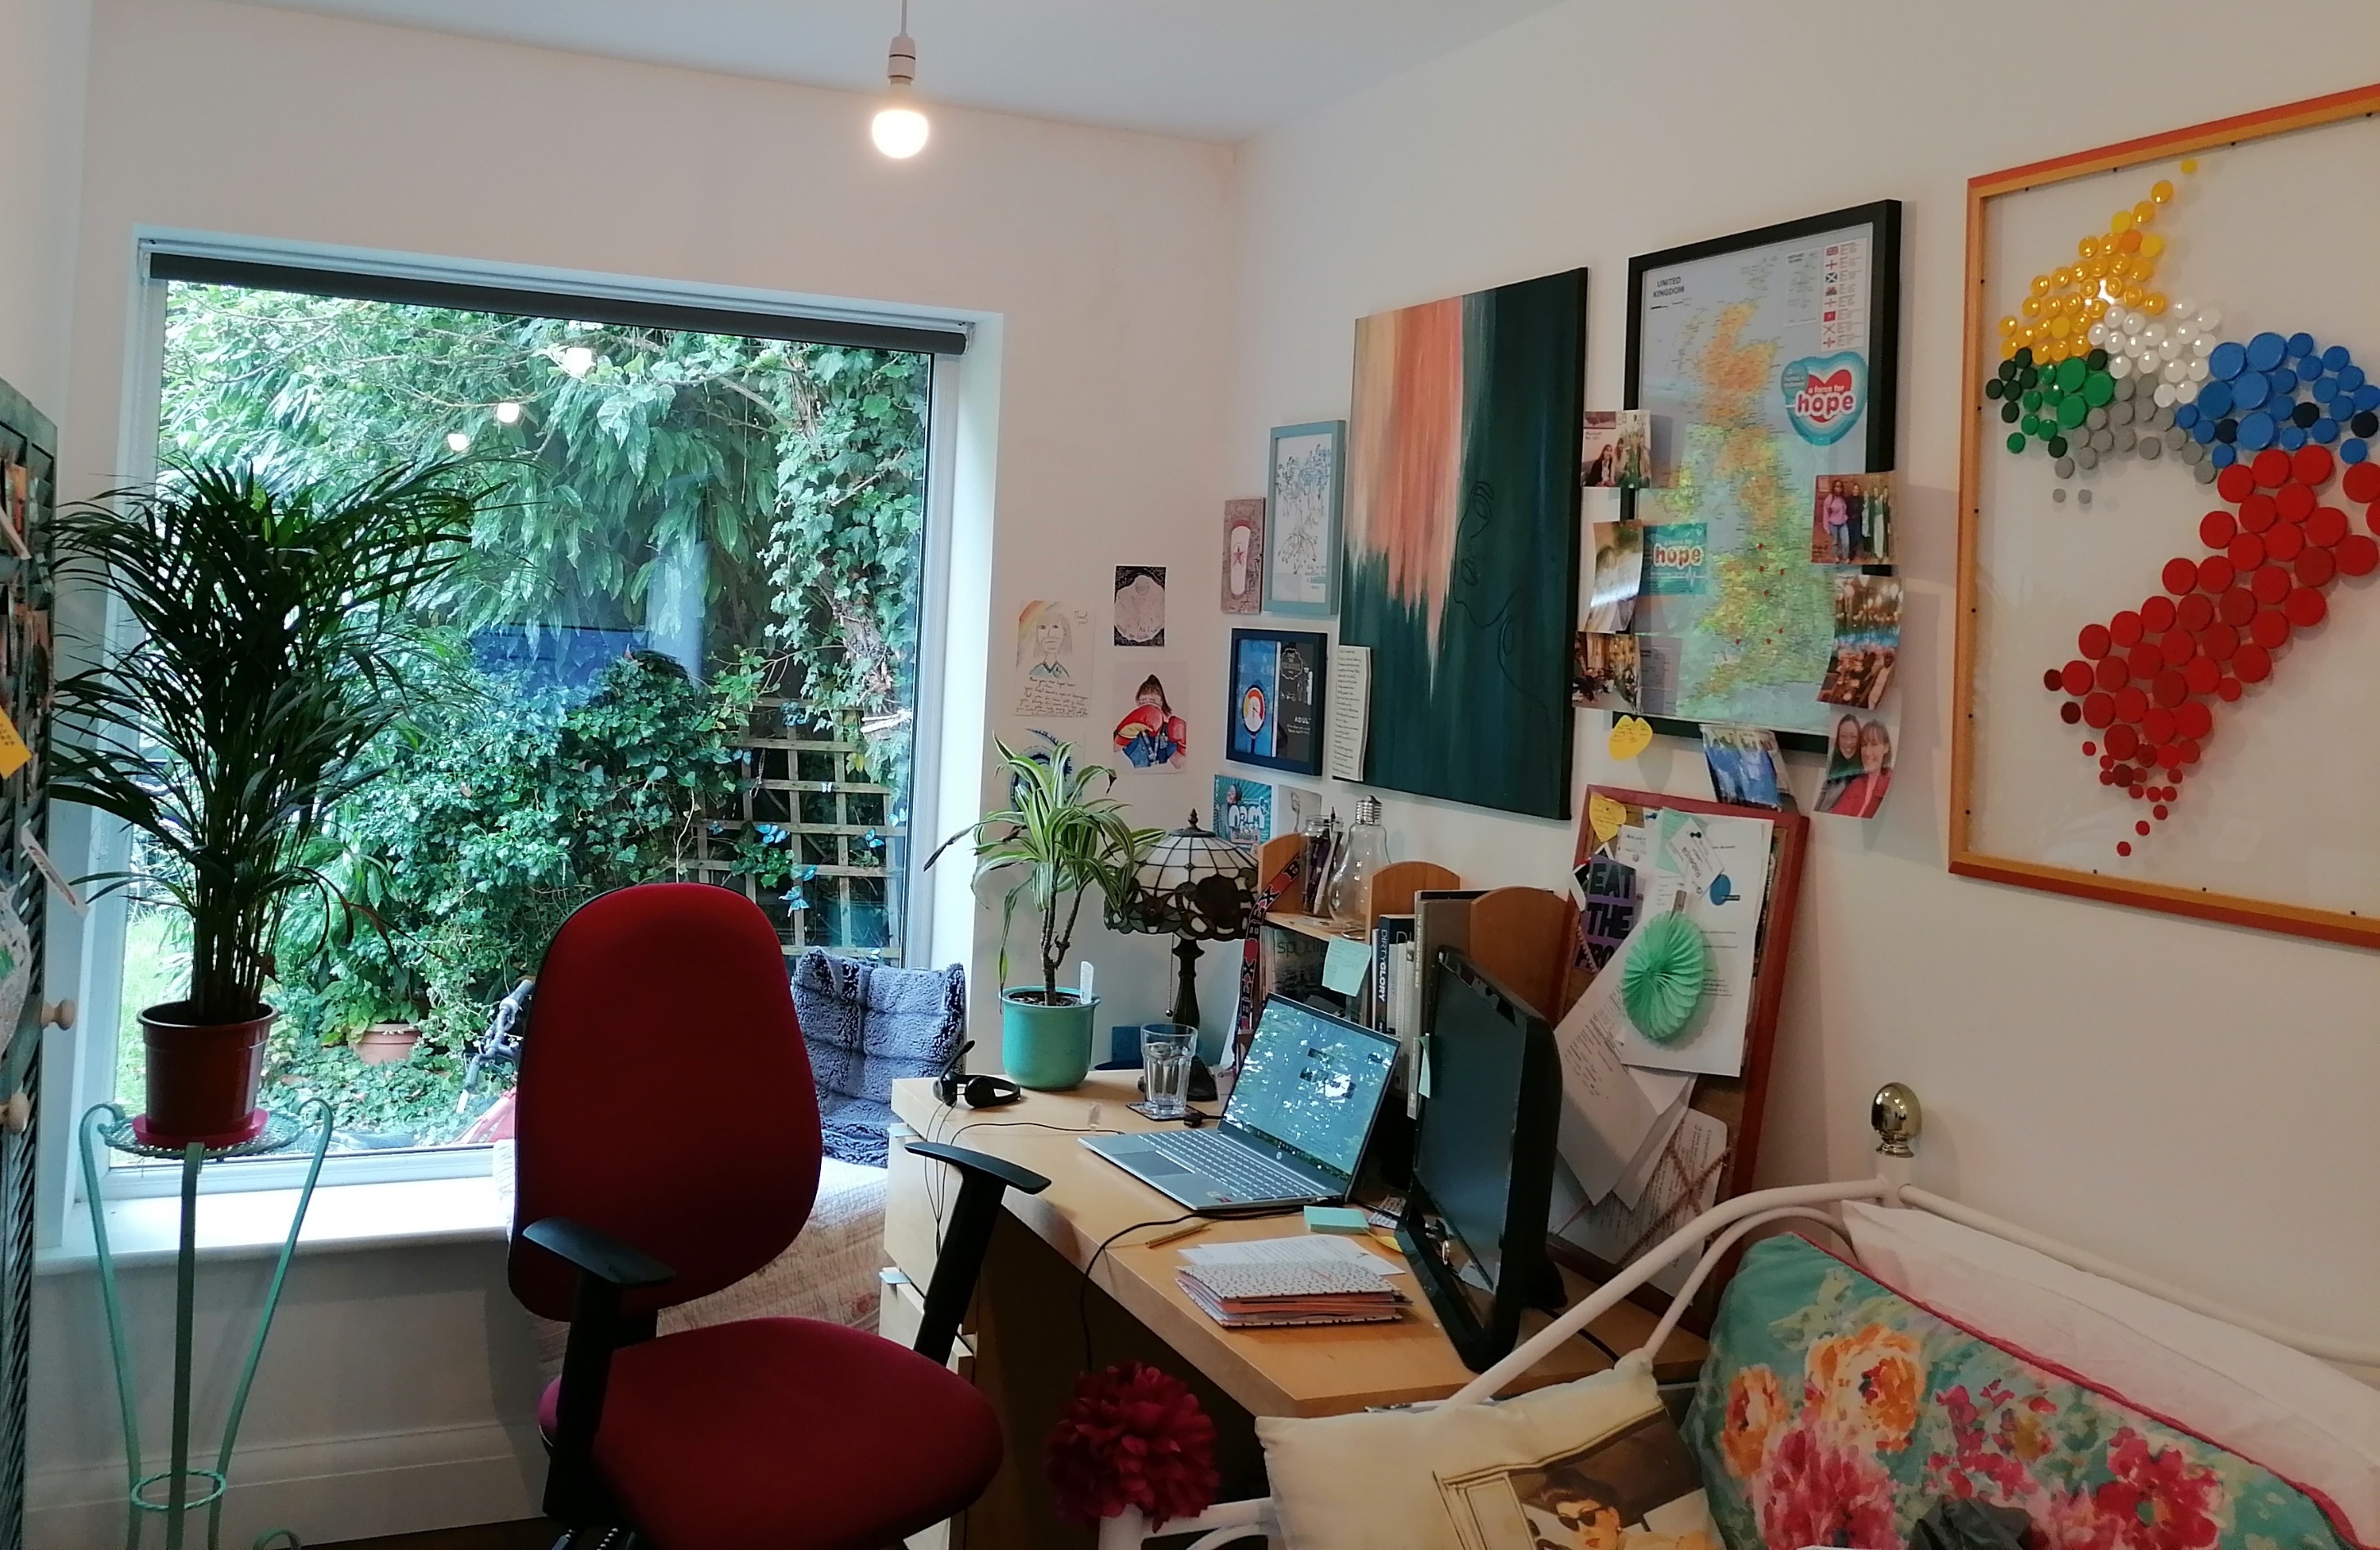
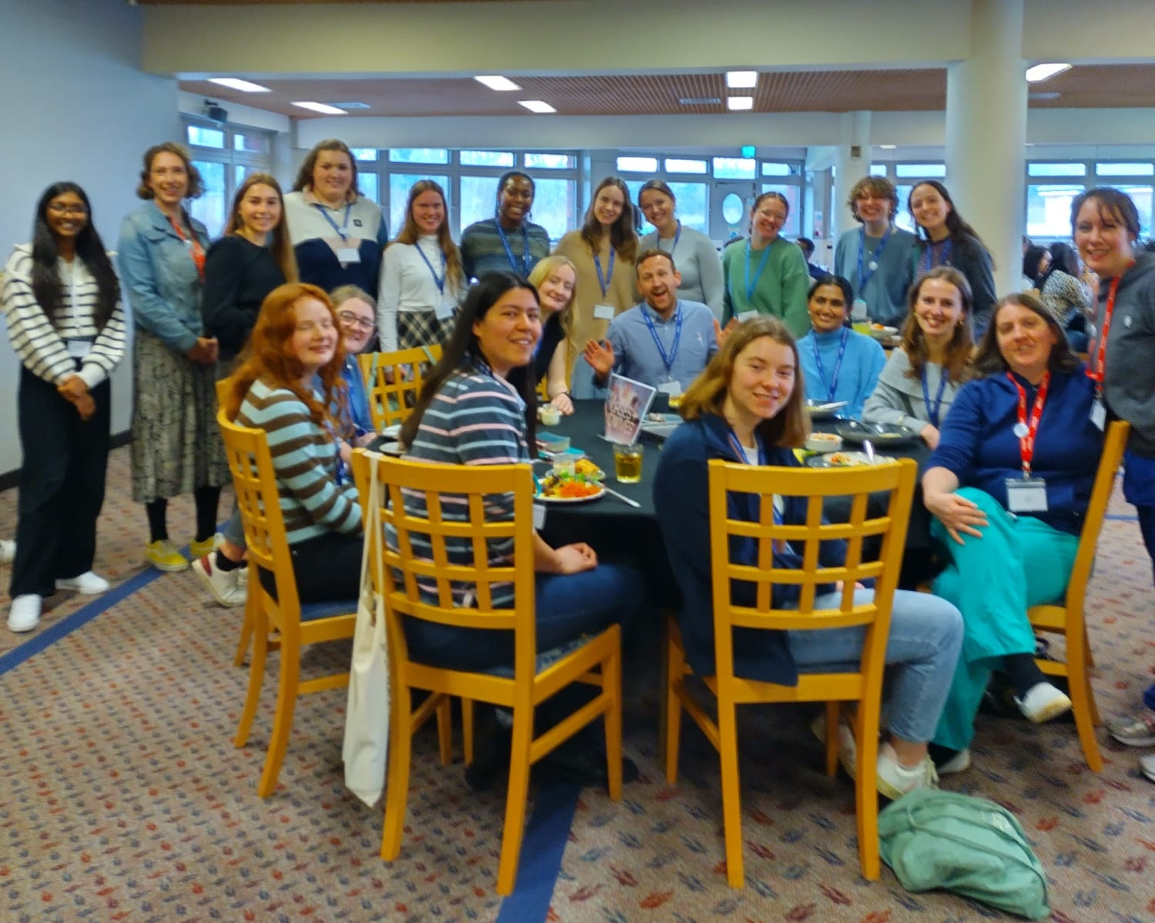
Head of Nurses
& Midwives at CMF

Slide 8
We all need encouragement.

Slide 9
We all need encouragement.
What do you want from me now?
You mean I have to thrive in my workplace too?

Slide 10
John 15

Slide 11
John 15 v. 9
‘As the Father has loved me, so I have loved you. Now remain in my love.’
1. It’s all about love

Slide 12
John 15 v. 5
‘I am the vine; you are the branches. If you remain in me and I in you, you will bear much fruit; apart from me you can do nothing.’
2. Thriving branches are naturally fruitful

Slide 13
In what ways are you being fruitful already in your workplace?

Slide 14
Modelling Godly character

Slide 15
Modelling Godly character
Making good work

Slide 16
Modelling Godly character
Making good work
Ministering grace and love

Slide 17
Modelling Godly character
Making good work
Ministering grace and love
Moulding culture

Slide 18
Modelling Godly character
Making good work
Ministering grace and love
Moulding culture
Mouthpiece for truth and justice

Slide 19
Modelling Godly character
Making good work
Ministering grace and love
Moulding culture
Mouthpiece for truth and justice
Messenger of the gospel

Slide 20
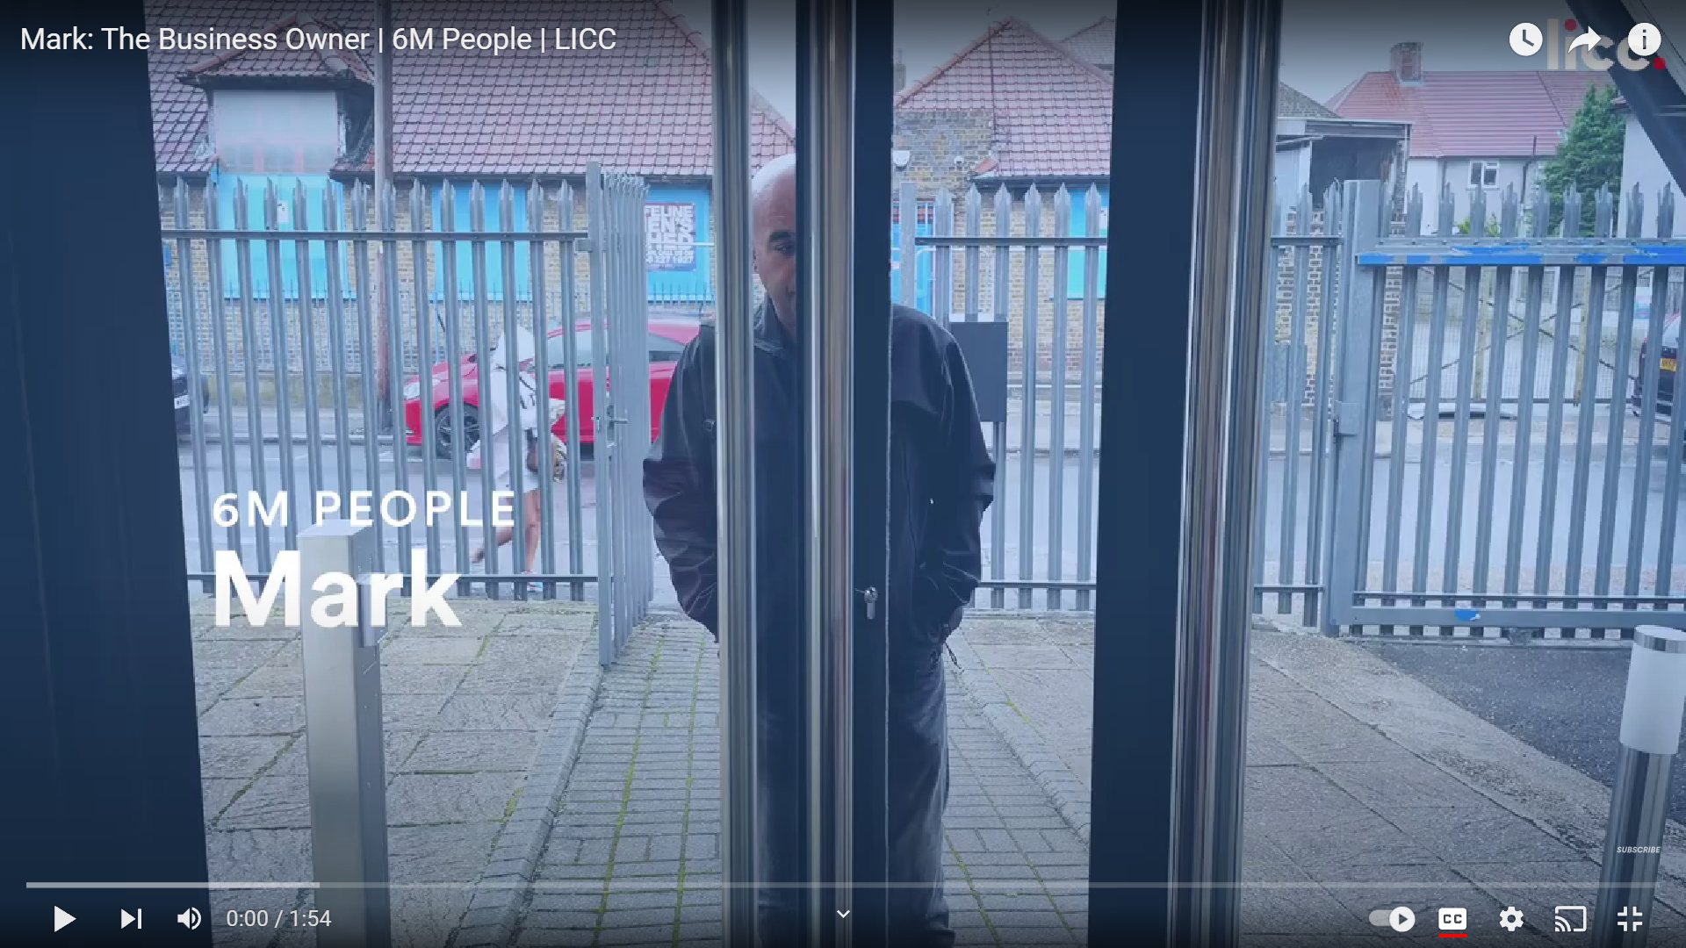
Mark: The Business Owner | 6M People | LICC - YouTube

Slide 21
Modelling Godly character
Making good work
Ministering grace and love
Moulding culture
Mouthpiece for truth and justice
Messenger of the gospel

Slide 22
What barriers are there to these fruits?
ⓘ Start presenting to display the poll results on this slide.

Slide 23
John 15 v. 7
‘’If you remain in me and my words in you, ask whatever you wish, and it will be done for you.’
3. Remain in Him

Slide 24
John 15
1. It’s all about love
2. Thriving branches are naturally fruity
3. Remain in Him

